Slide 1

Nutrition Pictures & Questions

Slide 2
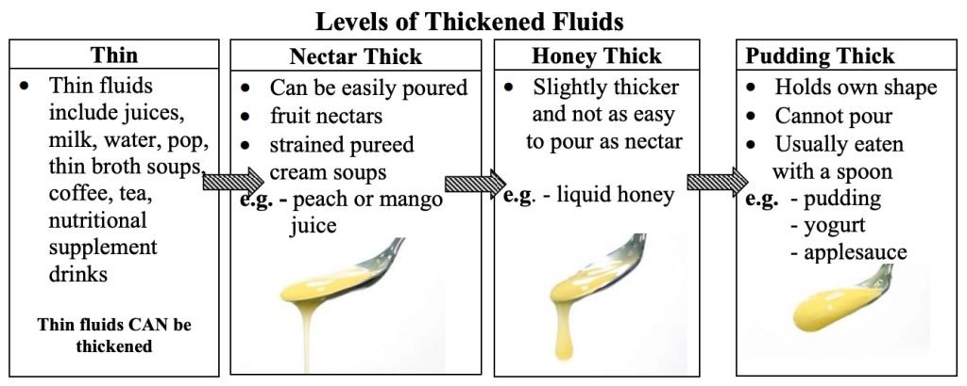
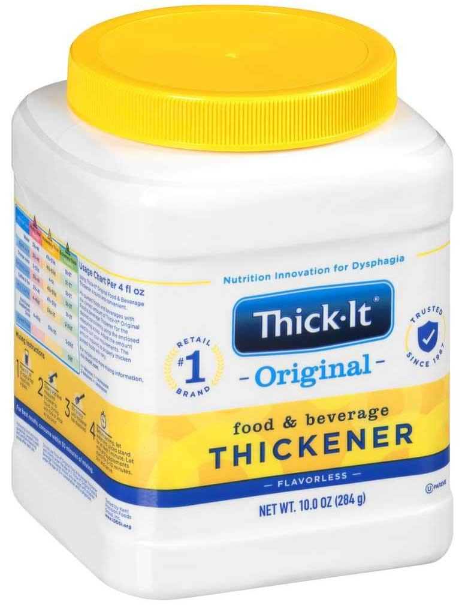
Thickened Liquids

Slide 3
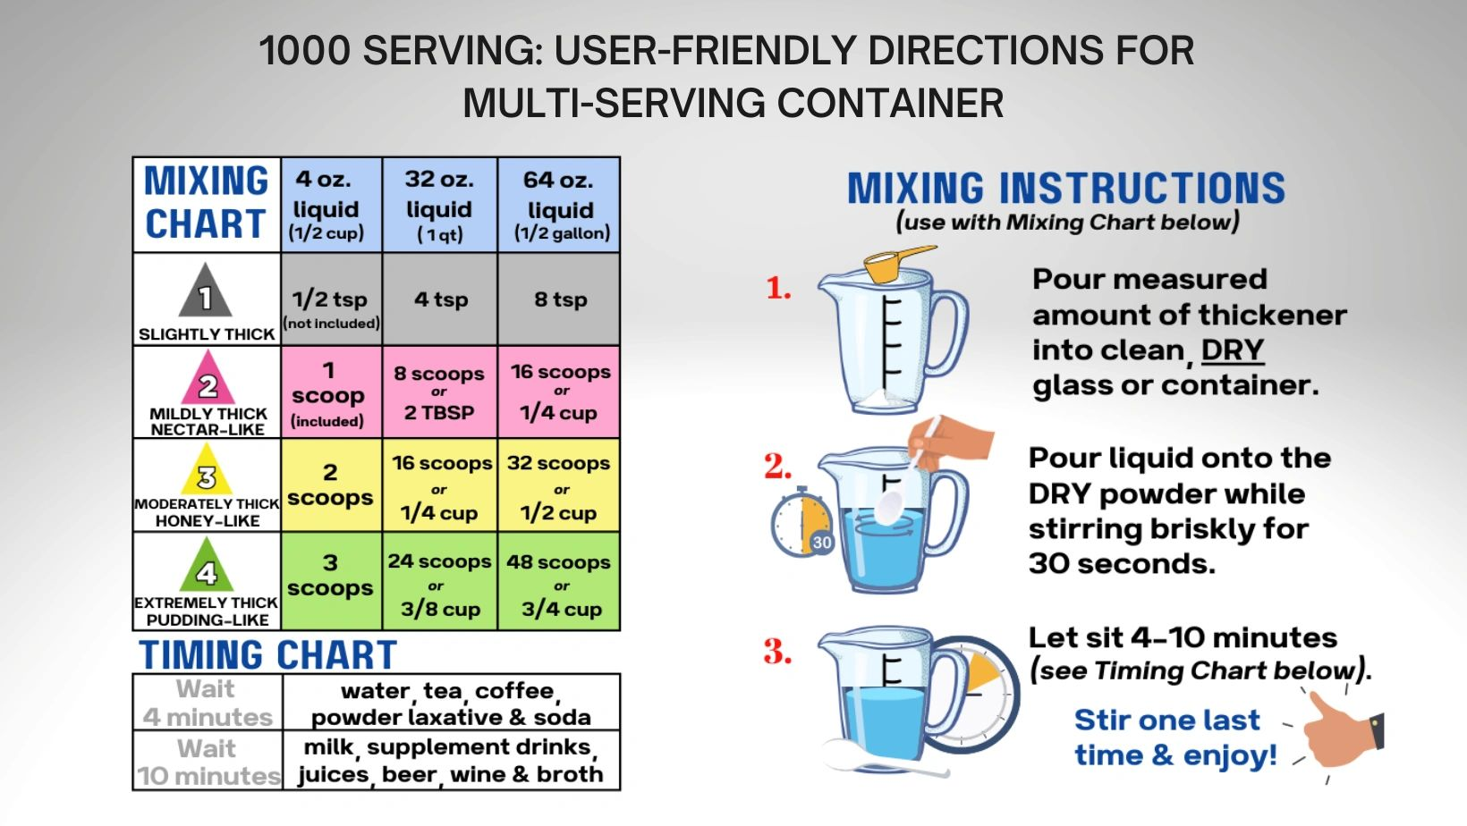

Slide 4
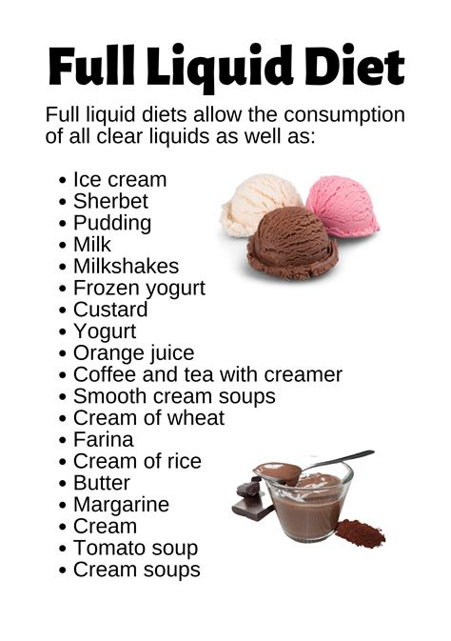
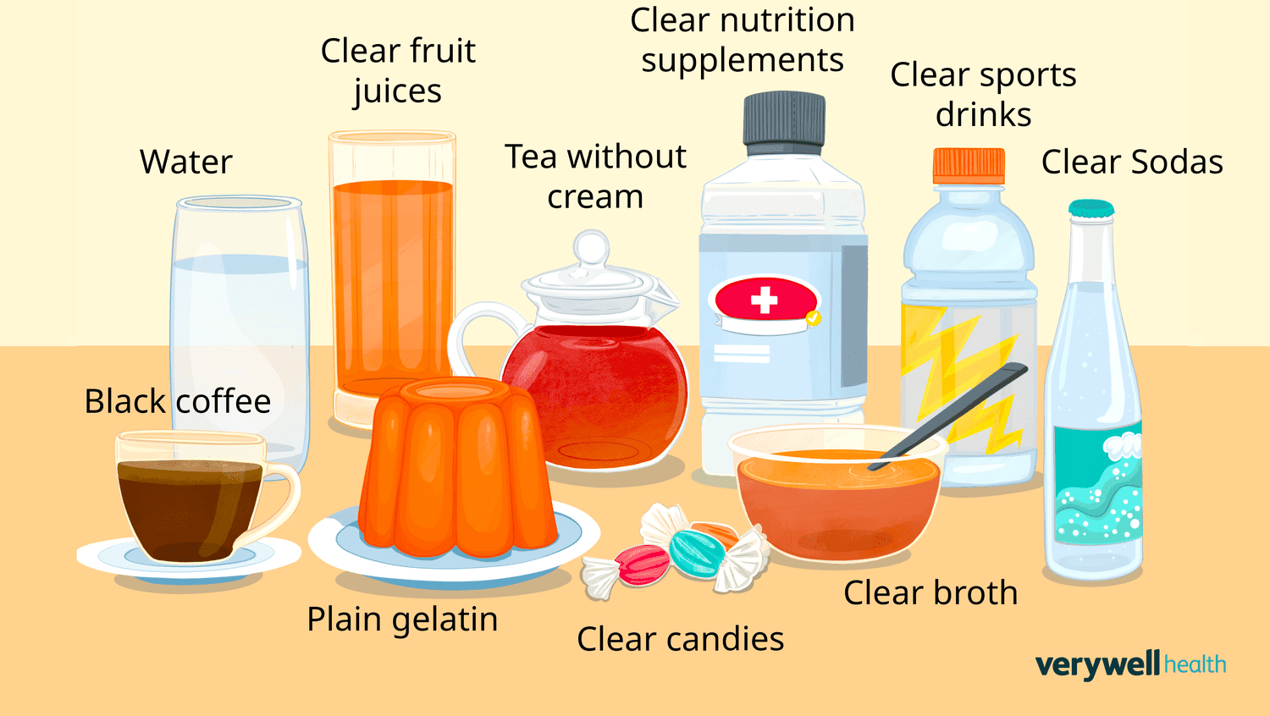
Clear Liquid Diet

Slide 5
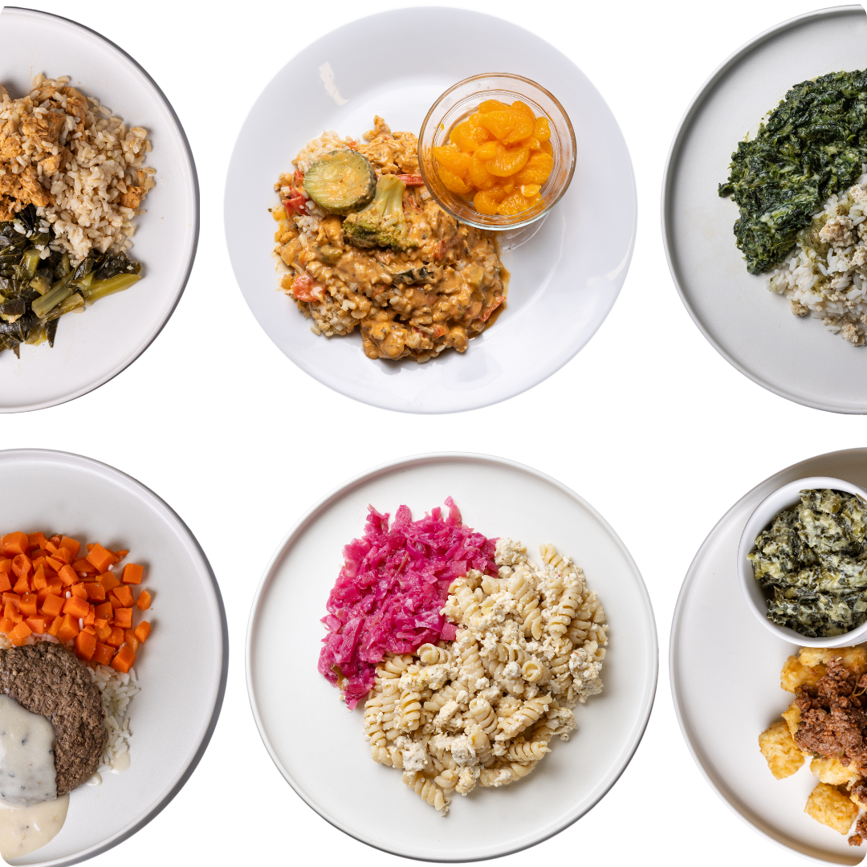
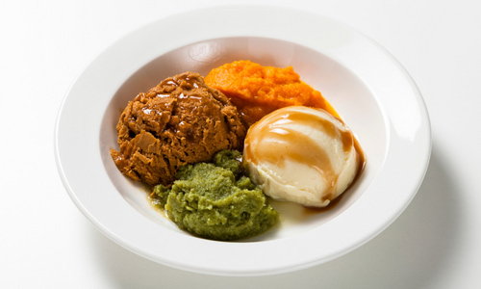
Texture-Modification Diets
Soft Mechanical
Pureed

Slide 6
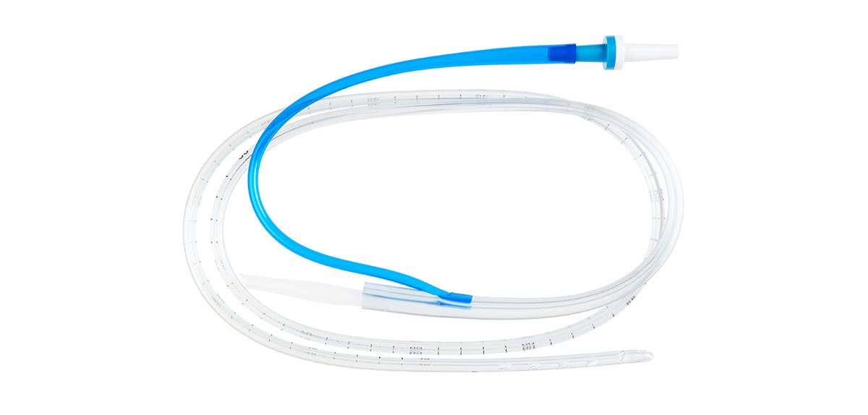
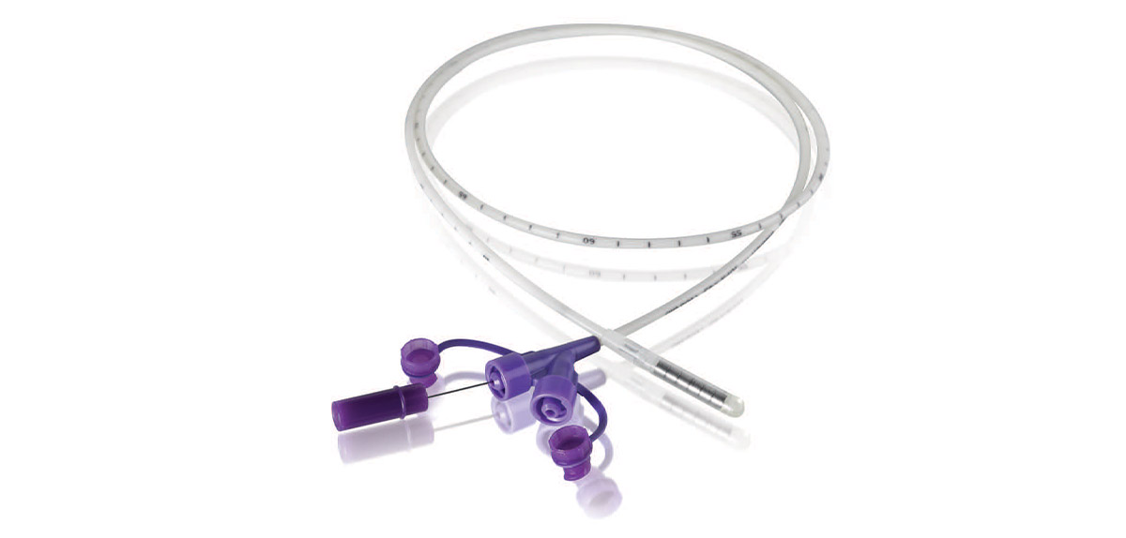
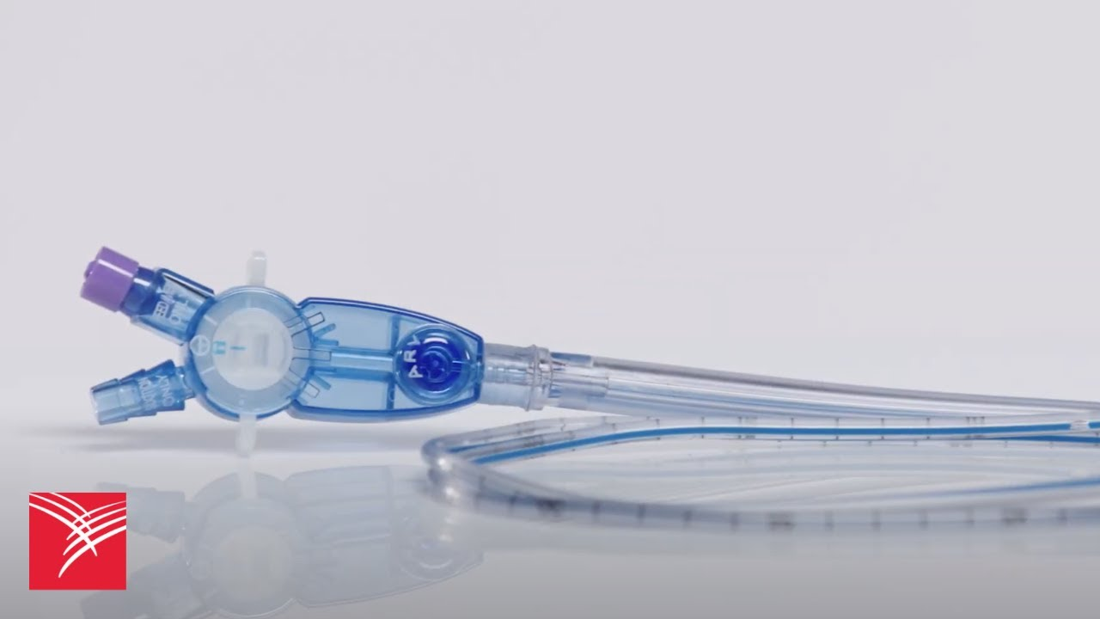
Types of NGTs
Salem Sump
Dobhoff/Feeding Tube

Slide 7
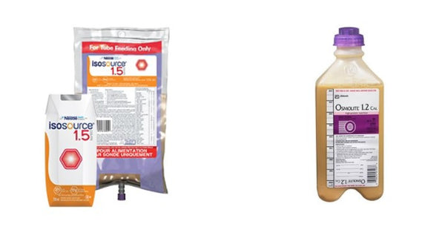
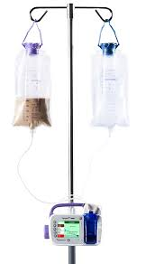
Enteral Feedings

Slide 8
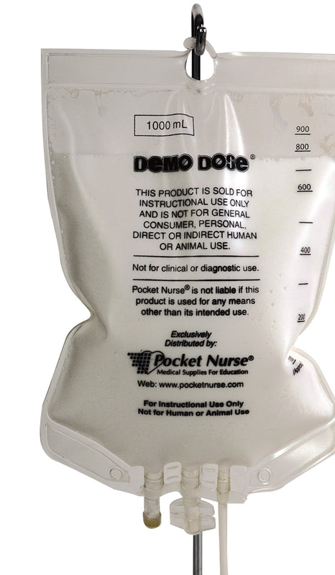
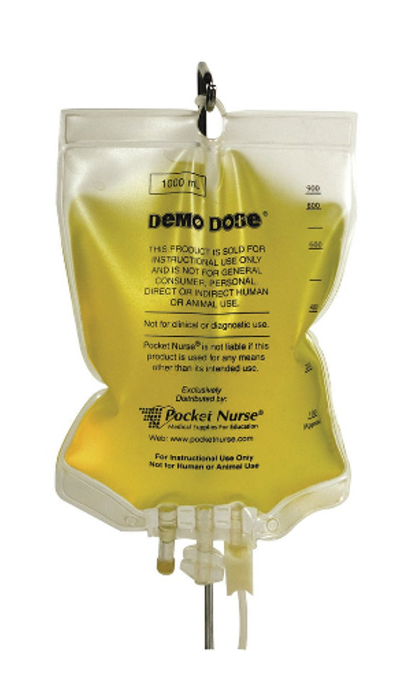
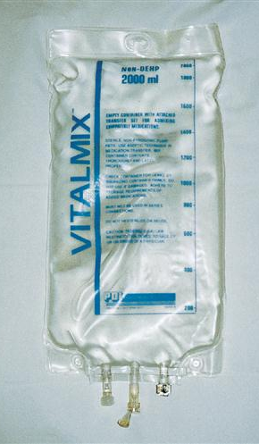
Parenteral Nutrition

Slide 9
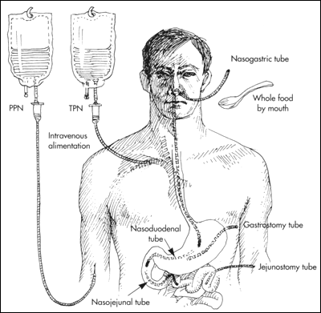
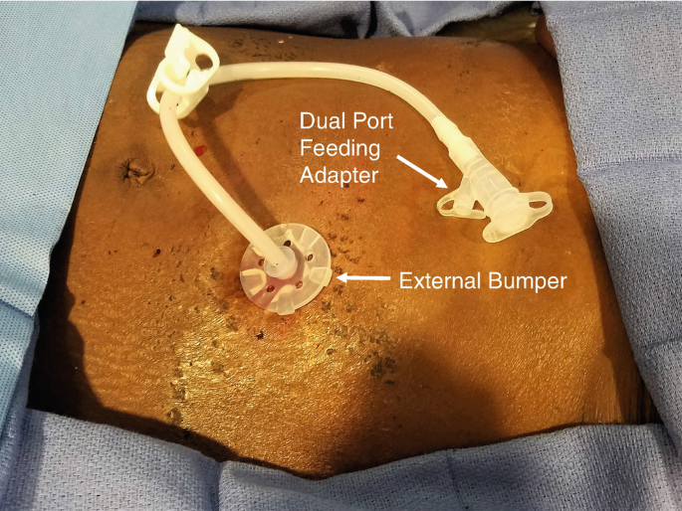
Feeding Tubes

Slide 10
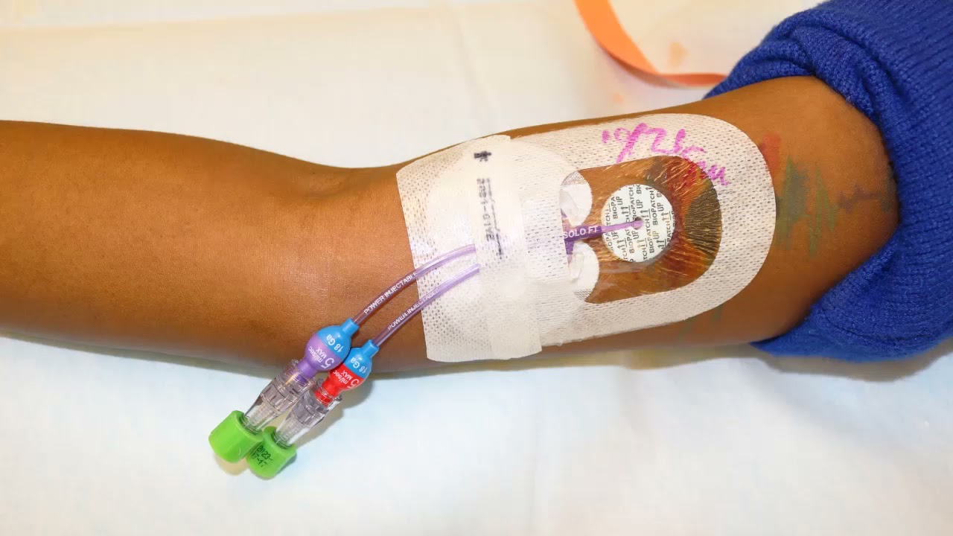
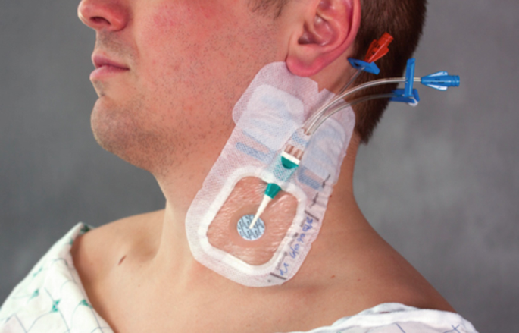
Types of Central Lines

Slide 11
The nurse is caring for a patient with a dysphagia diet and is feeding her pureed chicken. Suddenly the patient begins to choke. What is the priority nursing intervention?
A. Suction her mouth and throat
B. Turn her on her side
C. Apply 2L oxygen
D. Stop feeding her
Notes:
D

Slide 12
A patient is receiving both PN and EN. When would the nurse collaborate with the health care provider and request a discontinuation of PN?
When 25% of patient’s nutritional needs are met by the tube feedings
When bowl sounds return
When the central line has been in for 10 days
When 75% of patient’s nutritional needs are met by tube feeding
Notes:
D

Slide 13
A patient is receiving a continuous enteral feeding at 65ml/hr. The residual volume in 4 hours was 125ml. What is the priority nursing intervention?
Assess bowel sounds
Raise the head of the bed to at least 45 degrees
Continue the feedings; this is normal gastric residual for this feeding
Hold the feeding until you talk to the physician
Notes:
C

Slide 14
Which action can a nurse delegate to the assistive personnel?
Performing glucose monitoring q6h on a stable patient
Teaching the patient about the need for enteral feeding
Administering enteral feeding bolus after tube placement has been verified
Evaluating the patient’s tolerance of enteral feedings
Notes:
A

Slide 15
A nurse sees an AP perform the following interventions for a patient receiving continuous enteral feedings. Which action would require immediate attention by the nurse?
Fastening tube to the gown with new tape
Placing patient supine while giving a bath
Monitoring the patient’s weight as ordered
Ambulating patient with enteral feedings still infusing
Notes:
B

Slide 16
A patient is receiving TPN. What are the primary interventions the nurse should follow to prevent a central line infection? Select all that apply.
Change the dressing using sterile technique
Change TPN containers every 48 hours
Change TPN tubing every 24 hours
Monitor glucose levels to watch and assess for glucose intolerance
Elevate HOB to 45 degrees to prevent aspiration
Notes:
A, C

